Slide 1
AWARE Collapse Detection System
Zeyun Zhu,Pratyush Pandab,Perttu Pitkänen,Haejong Dong

Slide 2
Motivation
Design Process
System Design
Prototypes
Evaluation
Challenges
Next steps

Slide 3
Motivation 1/2
The biggest cause of deaths are the building collapses.
Building collapses happen even in countries that build their buildings earthquake resistant.
Our system could be great help for people living in high earthquake risk areas, providing help and guidance in the time of crisis.
The system would also provide the location of collapsed buildings to the emergency response units for their rapid deployment.

Slide 4
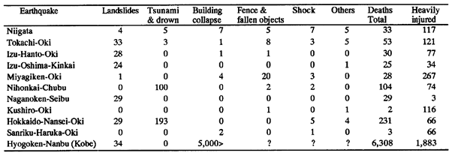
Motivation 2/2
The earthquake in Kobe City
Number of deaths 6308 of which about 5000 were because of collapsed buildings
many people were injured

Slide 5
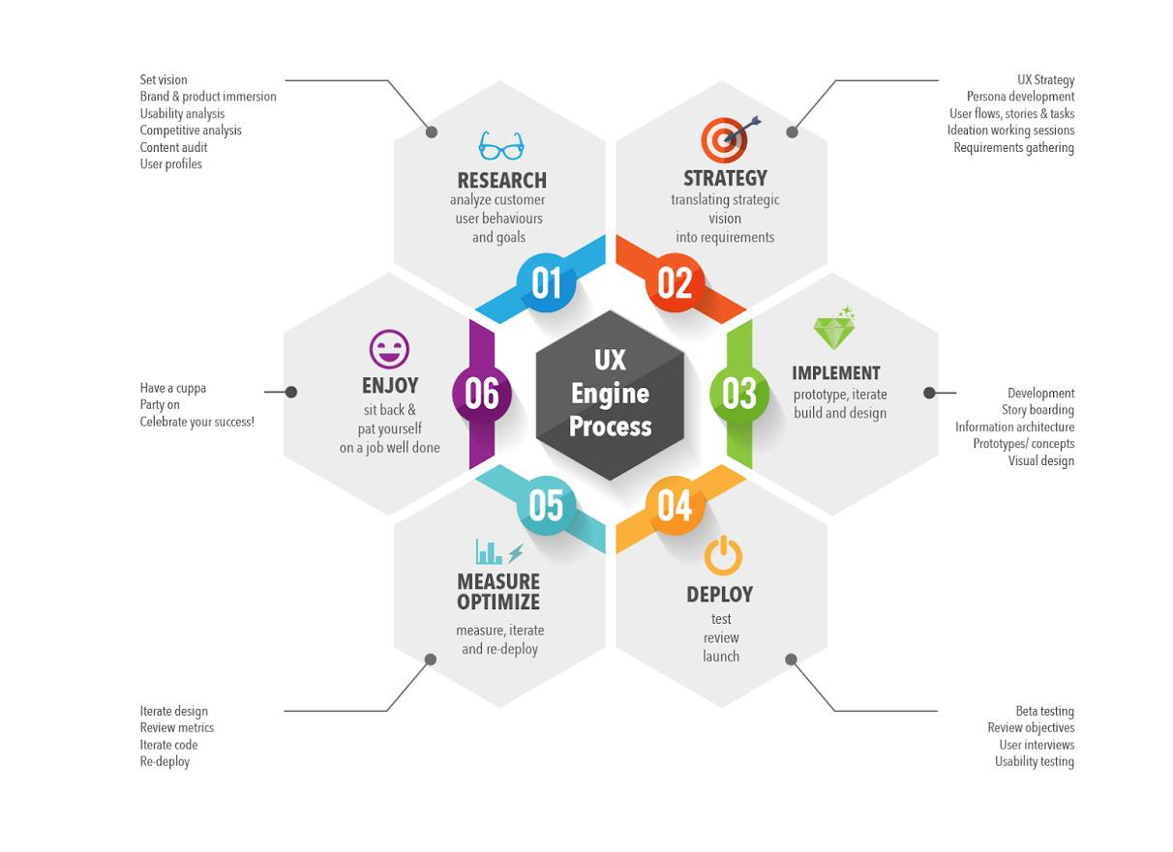
Design process

Slide 6
Literature review
Key findings
Damage assessment takes time.
Traditional high fidelity seismic sensors generate low resolution maps and are sparsely distributed (10 Km. in case of SCSN).
Increasing the density of such networks is expensive.
Mobile crowdsourcing is promising (project “did you feel it” produced over 40 000 entries).
Data entry is not the first priority of users.
Low cost MEMS are now in built into smartphones.
It is difficult to model human behaviour.

Slide 7
Literature review
State of the art
Earthquakes are monitored effectively with high fidelity seismic sensors.
Systems to detect earthquake with smartphones exists. These systems do not detect building collapses.
One approach is to detect building collapses from aerial photographs.
There are no systems that are used to detect building collapses with smartphones.
Collapsing building is studied only by the architect

Slide 8
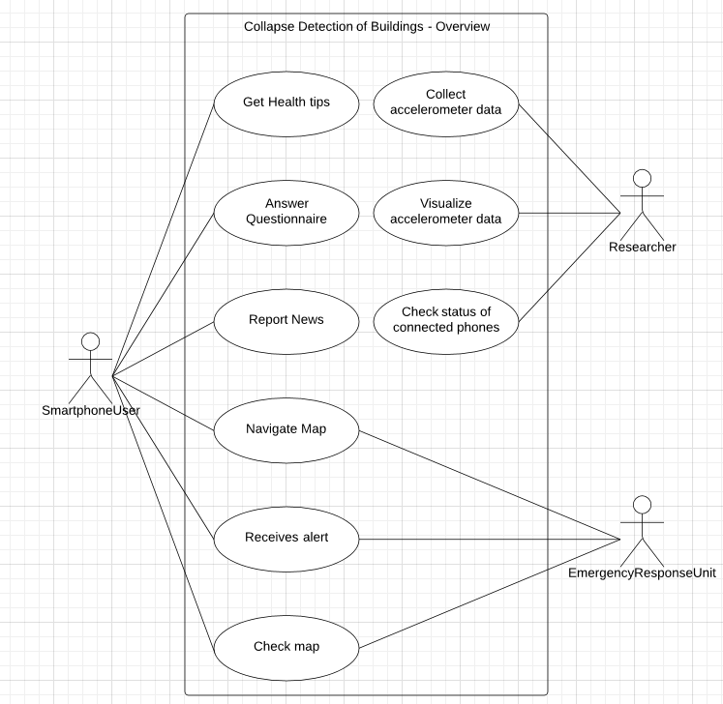
Use cases

Slide 9
System design
Overview of the system
Sequence diagram
flow diagram

Slide 10
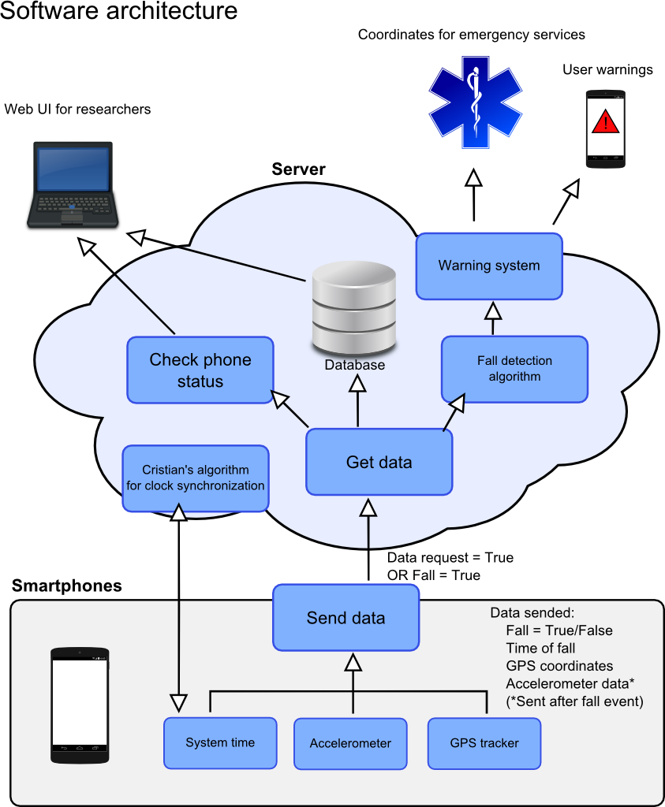
System design

Slide 11
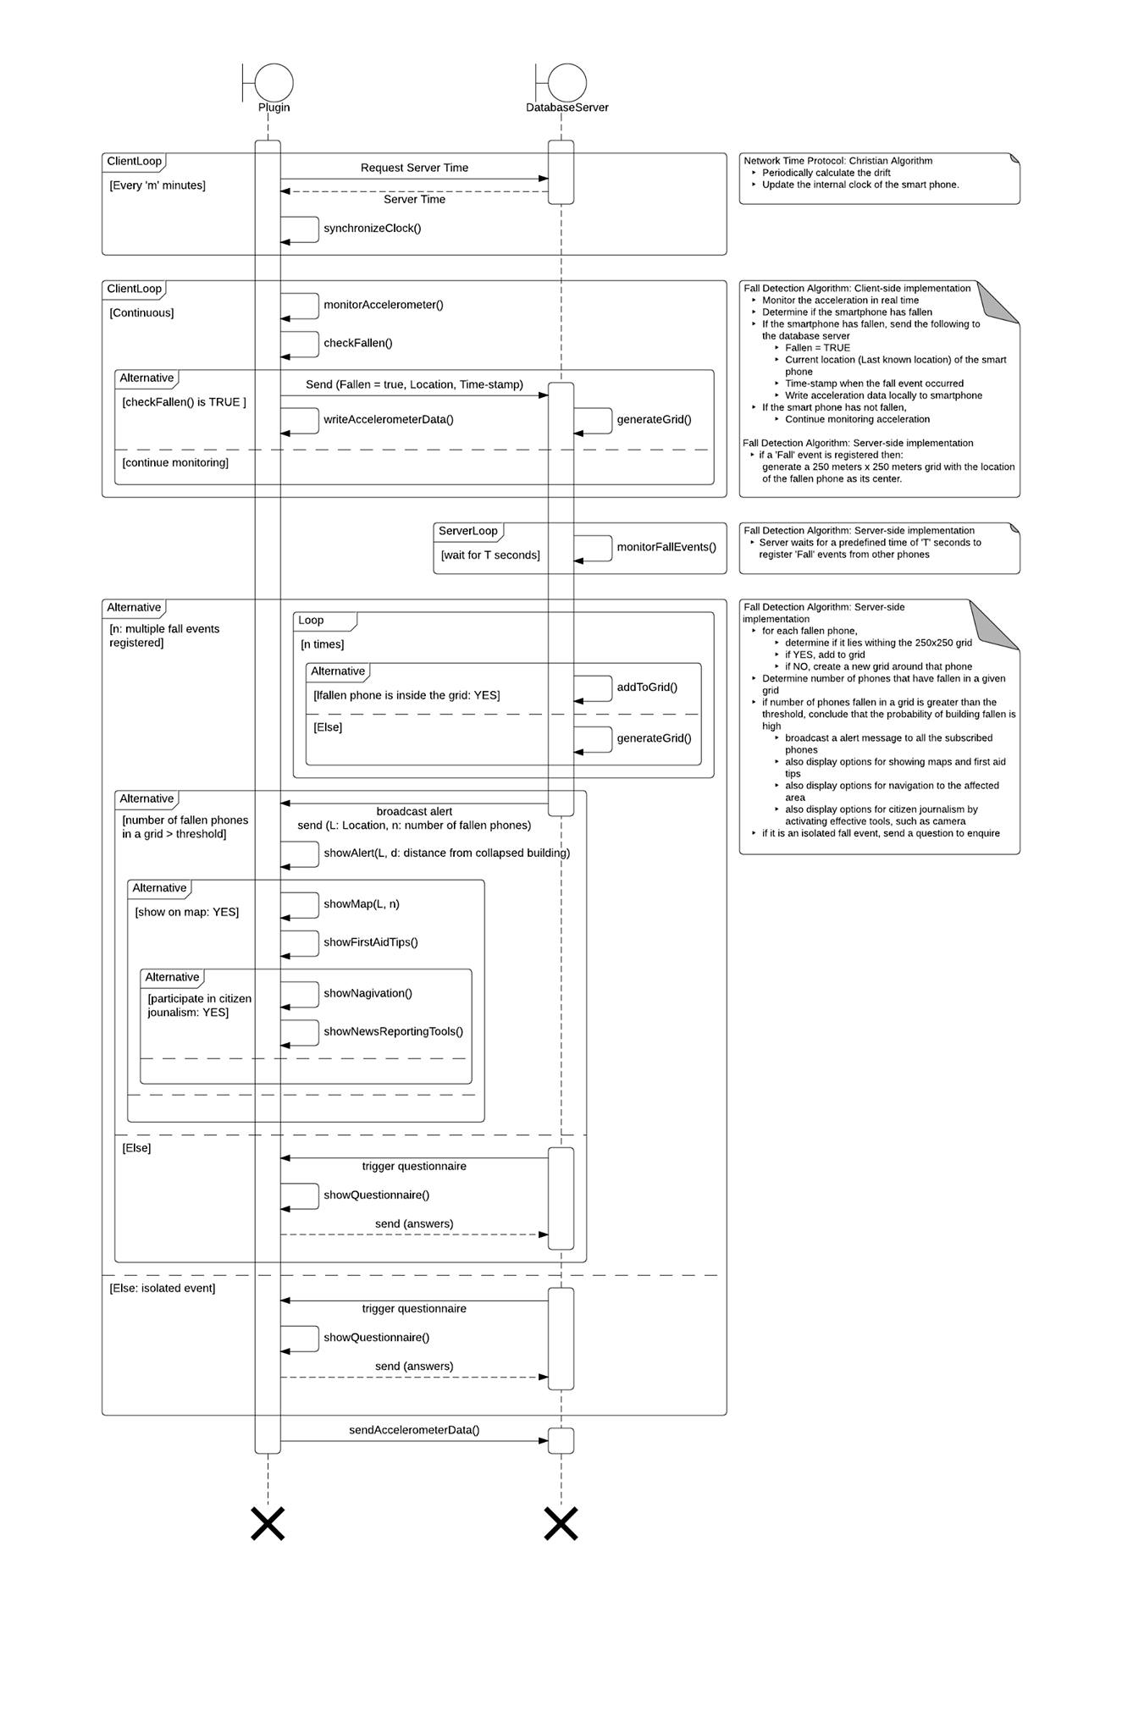
Sequence Diagram

Slide 12
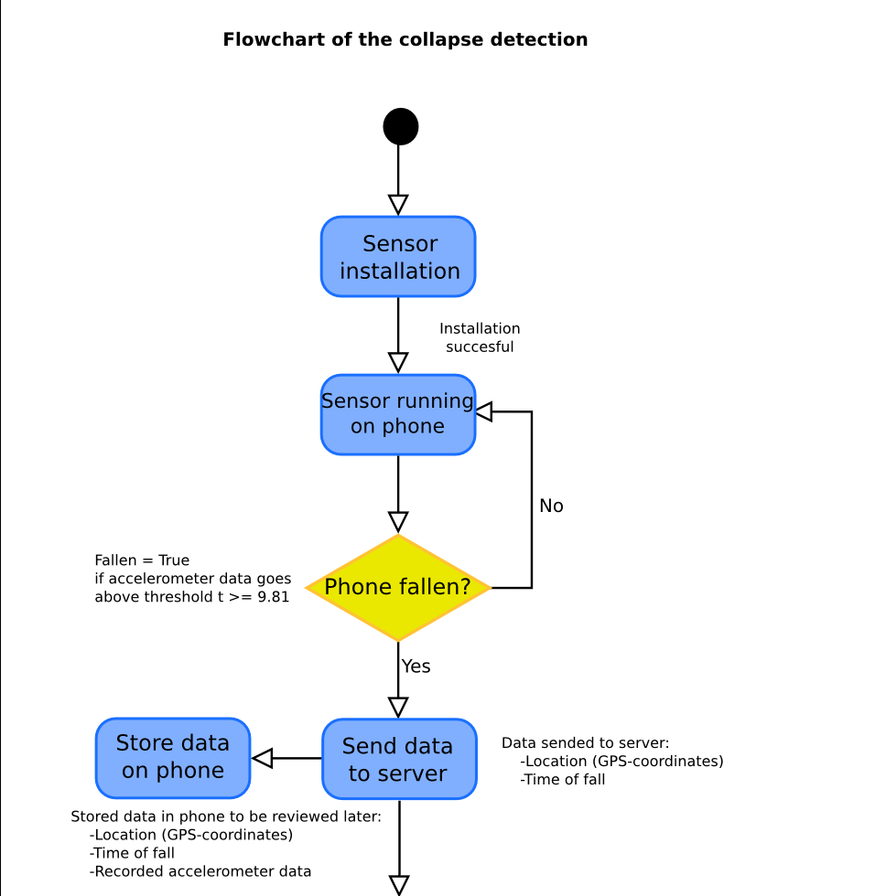
Flow diagrams

Slide 13
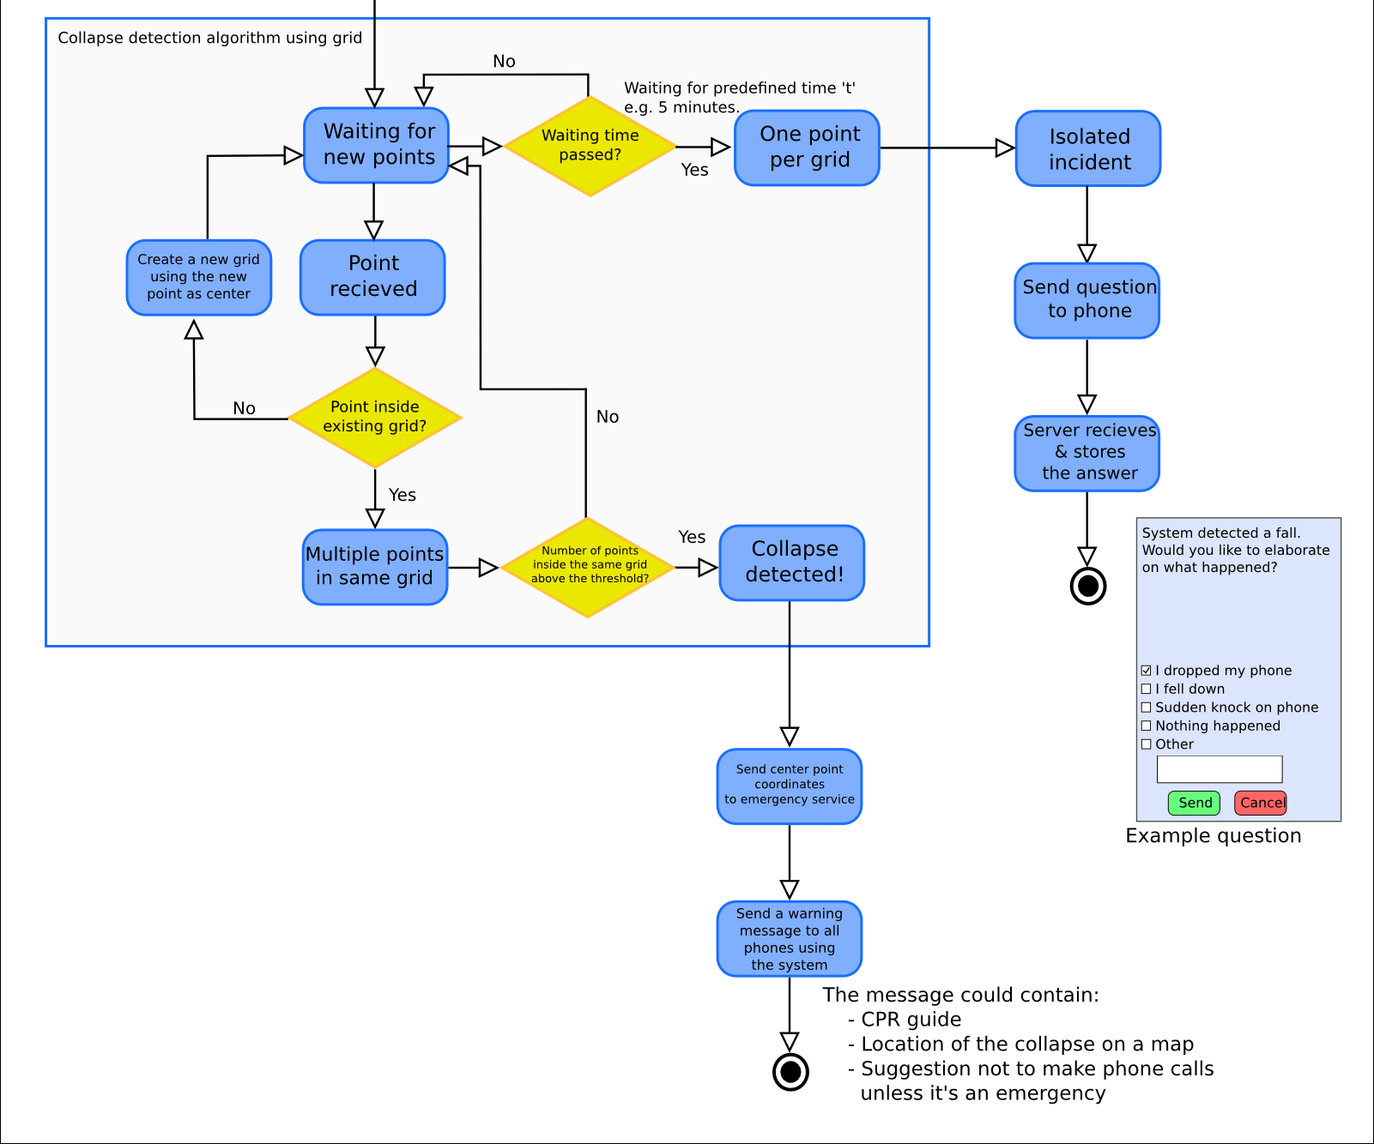

Slide 14
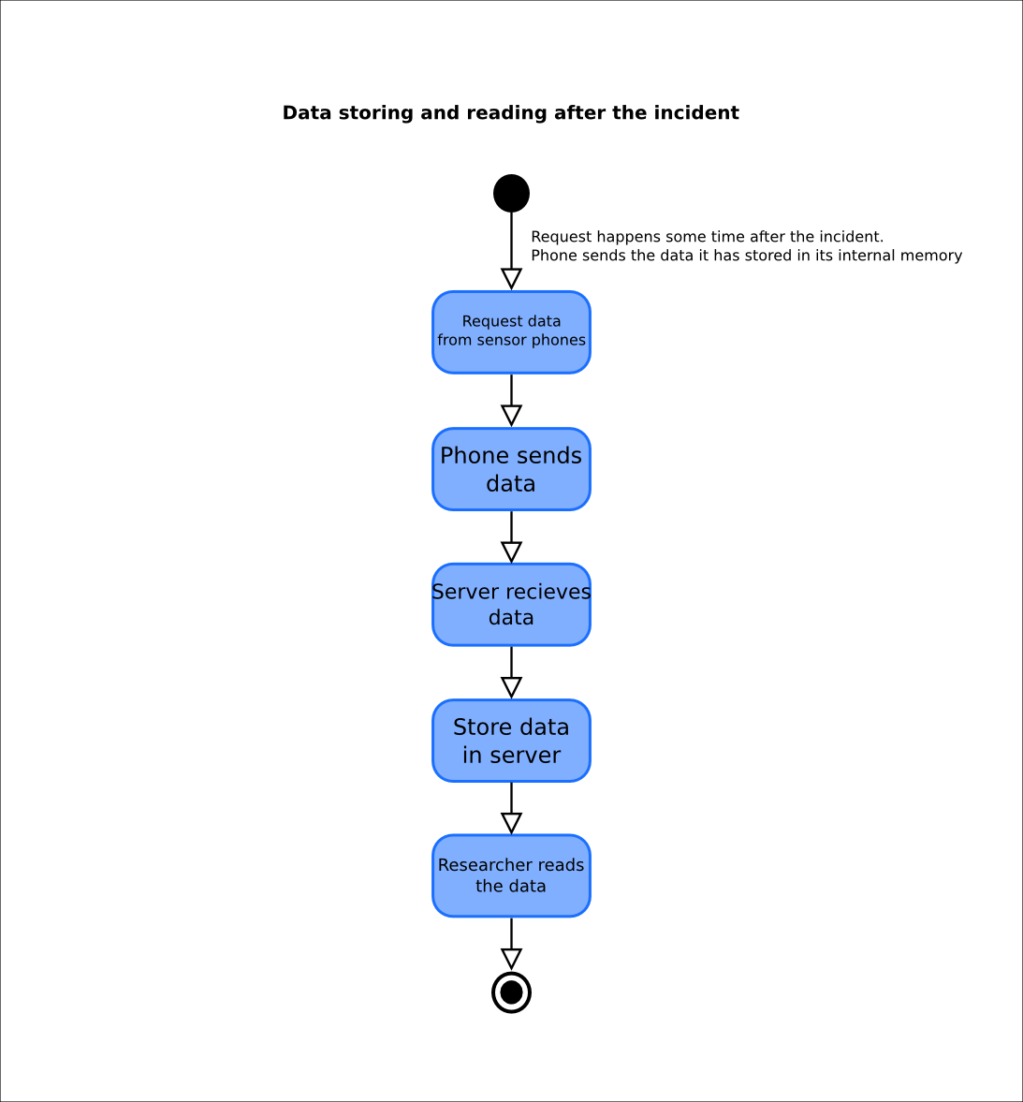

Slide 15
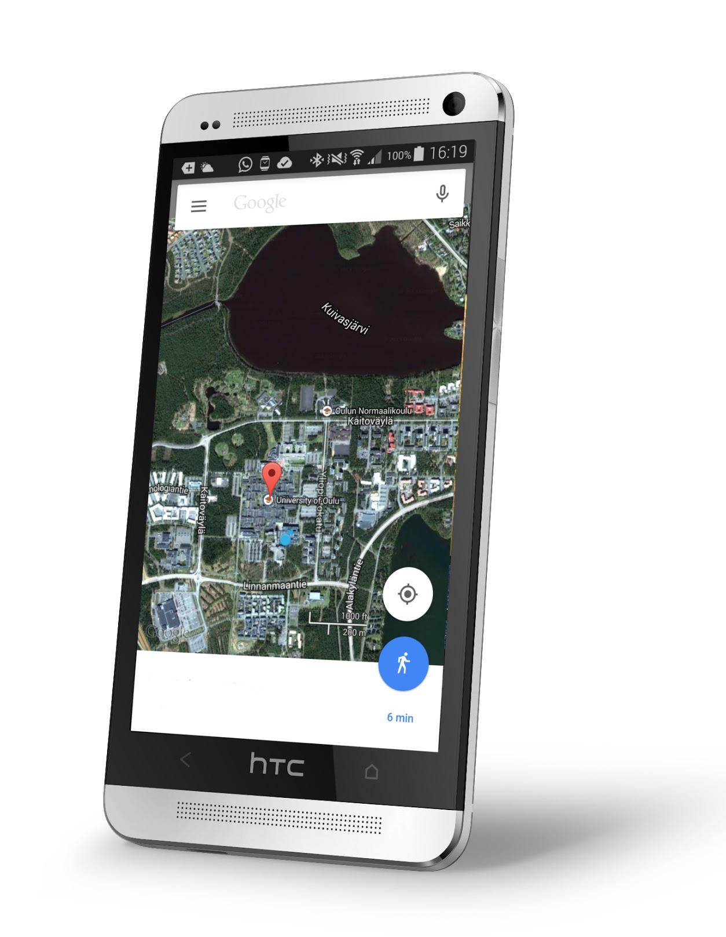
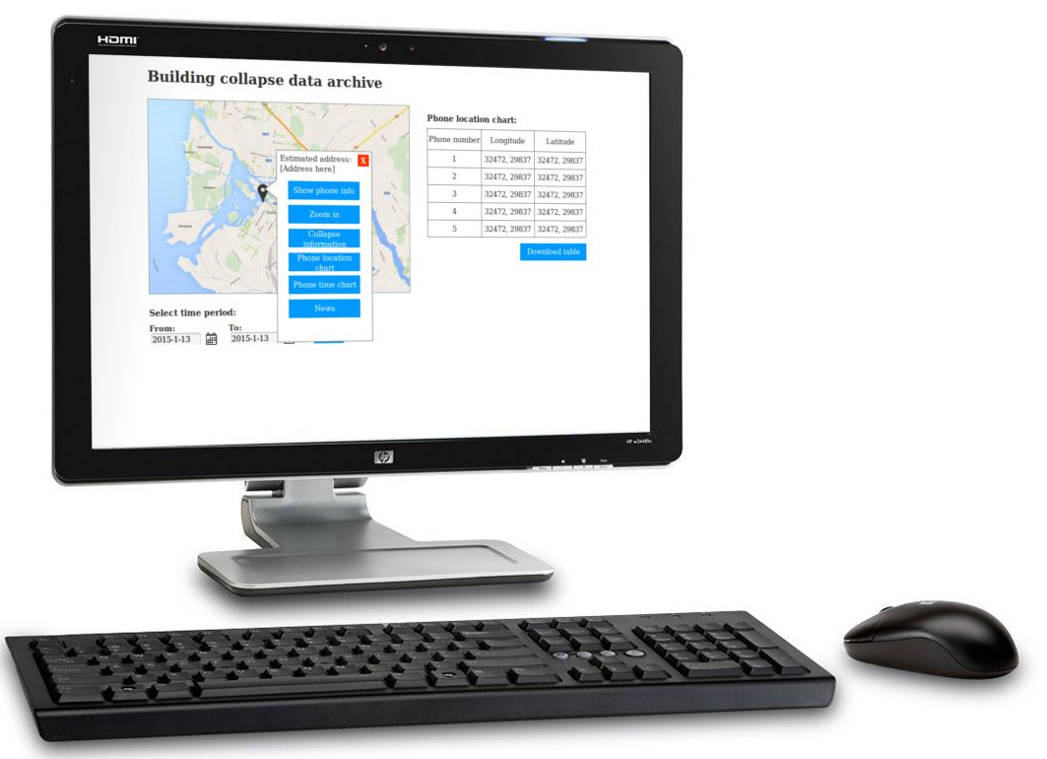
Prototypes
Phone UI for end users
Web UI for researchers

Slide 16
Prototypes
Mobile UI
http://tinyurl.com/onvvps4
Web UI
http://tinyurl.com/ojw4ggn

Slide 17
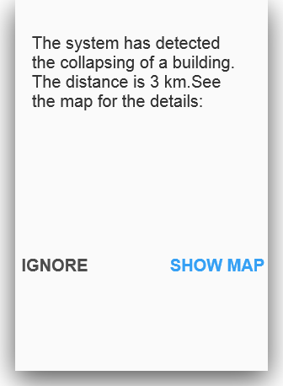
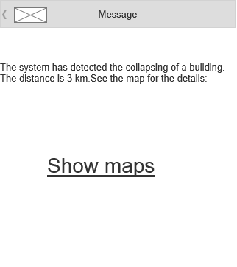
Prototypes: Phone UI

Slide 18
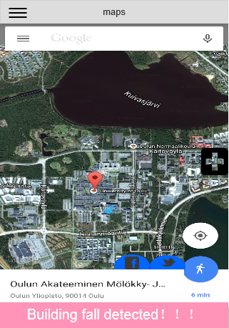
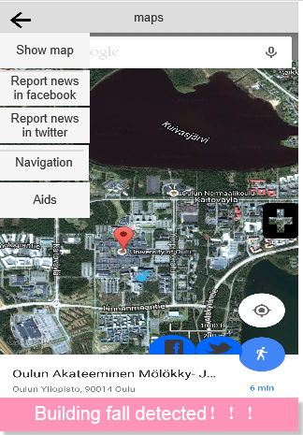
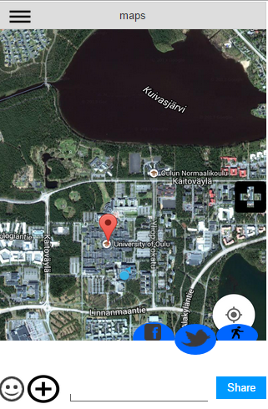
Prototypes: Phone UI

Slide 19
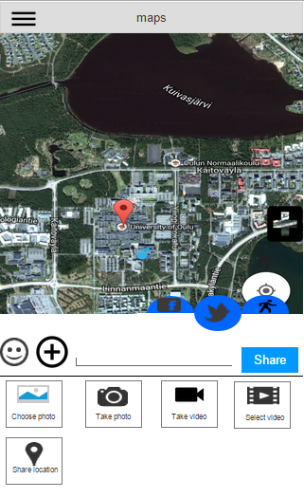
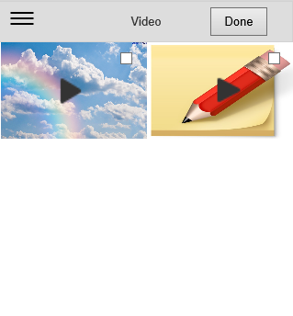
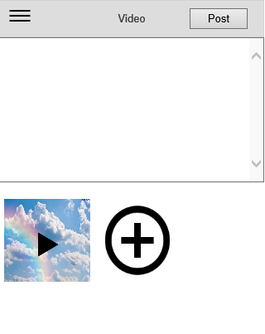
Prototypes: Phone UI

Slide 20
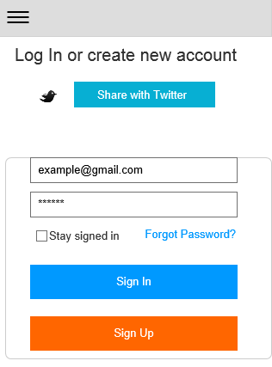
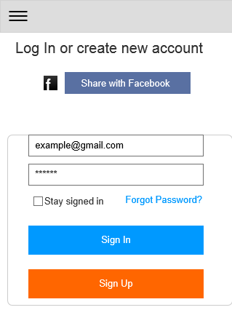
Prototypes: Phone UI

Slide 21
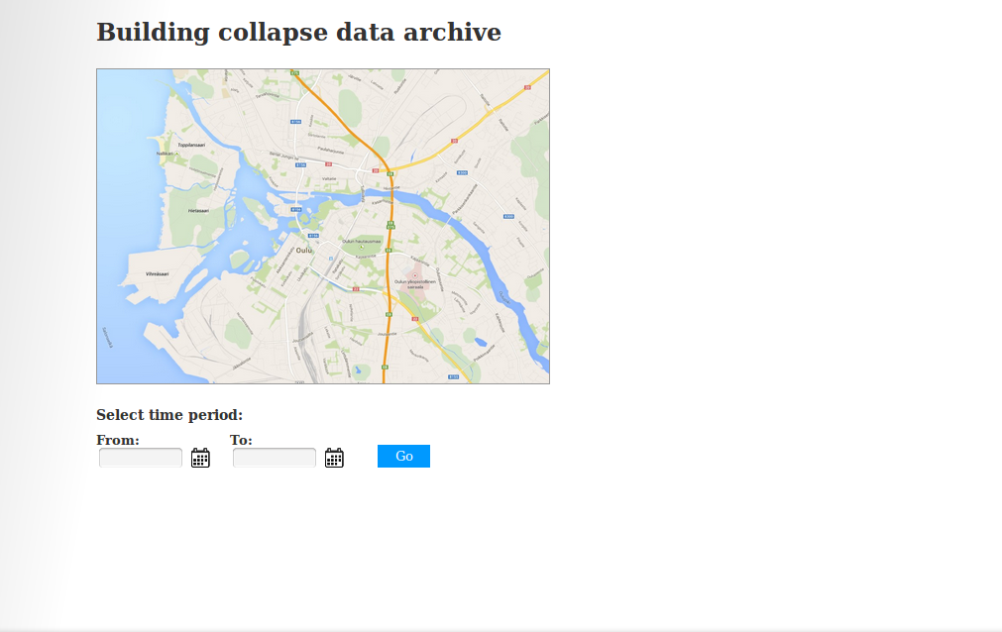
Prototypes: Web UI

Slide 22
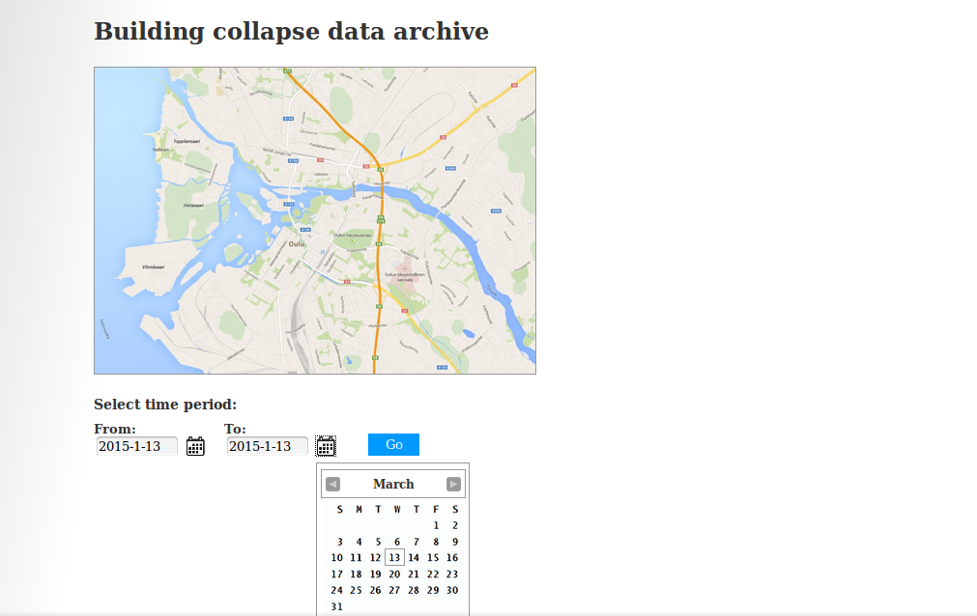
Prototypes: Web UI

Slide 23
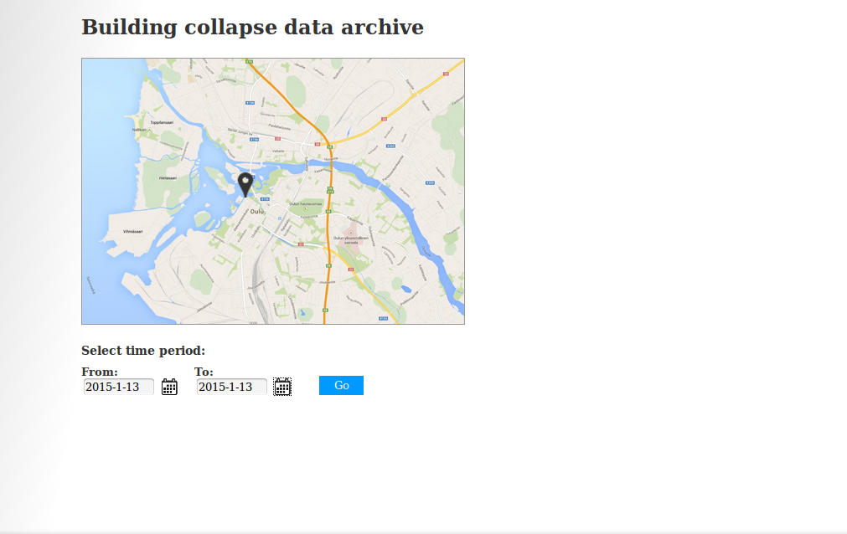
Prototypes: Web UI

Slide 24
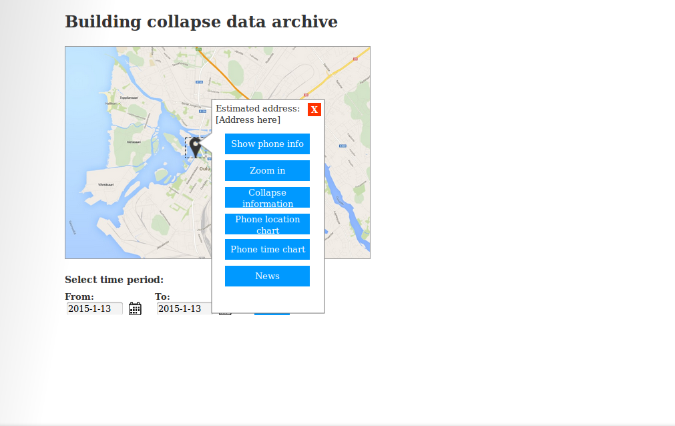
Prototypes: Web UI

Slide 25
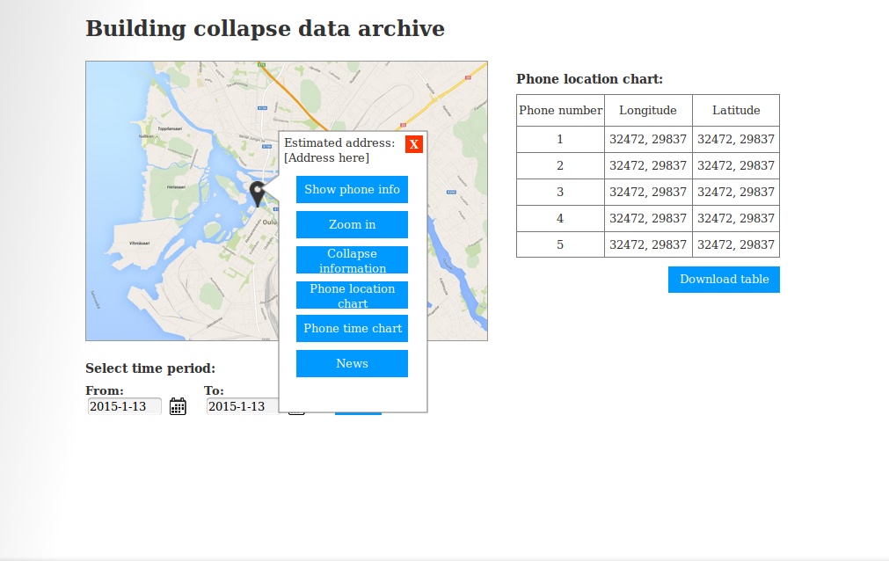
Prototypes: Web UI

Slide 26
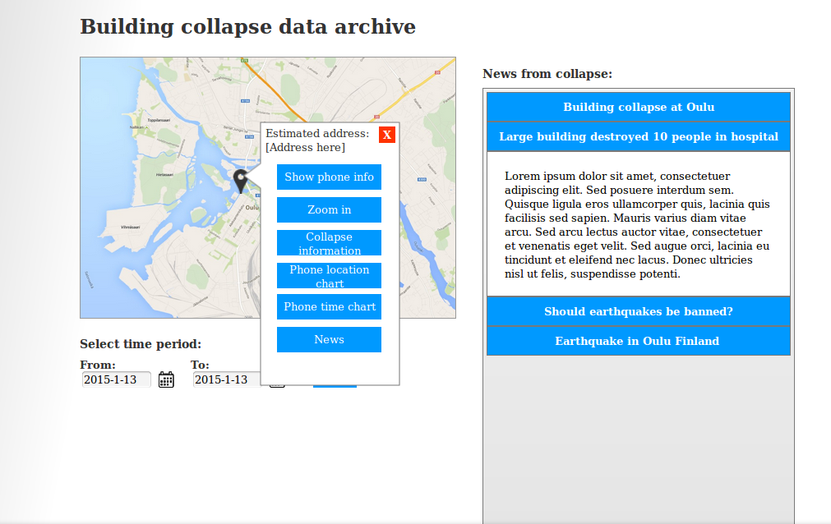
Prototypes: Web UI

Slide 27
Evaluation
Quick and Dirty Expert evaluation
Neilson Heuristics

Slide 28
Challenges
Threshold values for fall detection and collapse area.
Simulating 1000 phones.

Slide 29
Next steps: Implementation
Aware Implementation
Orientation of phones
Time synchronization
Free-fall of phones
Server side Implementation
Fall detection
Communication services

Slide 30
Next steps: Evaluation
User evaluation
Concurrent Think Aloud
Technical evaluation
Speed
Consistency
Accuracy
Reliability

Slide 31
Additional functionalities
Adaptive thresholding
Monitoring earthquakes seismic waves to increase the reliability of the fall detection

